Slide 1

Comprehensive Real Mart Data Analysis
Explore the comprehensive data analysis of Real Mart's sales patterns, customer behavior, and store performance metrics to uncover insights and drive strategic growth.
BY
B.YAGNESH[192224177]
Y.MOUNIKA[192224221

Slide 2
Understanding Real Mart's Business Model
Diverse Product Offerings
Omnichannel Approach
Loyalty Program
Real Mart caters to a wide range of customer needs with its expansive inventory of merchandise across various categories.
Customers can shop in-store, online, or through mobile apps, providing a seamless and convenient shopping experience.
Real Mart's loyalty program rewards customers for their patronage, driving repeat business and data-driven insights.

Slide 3
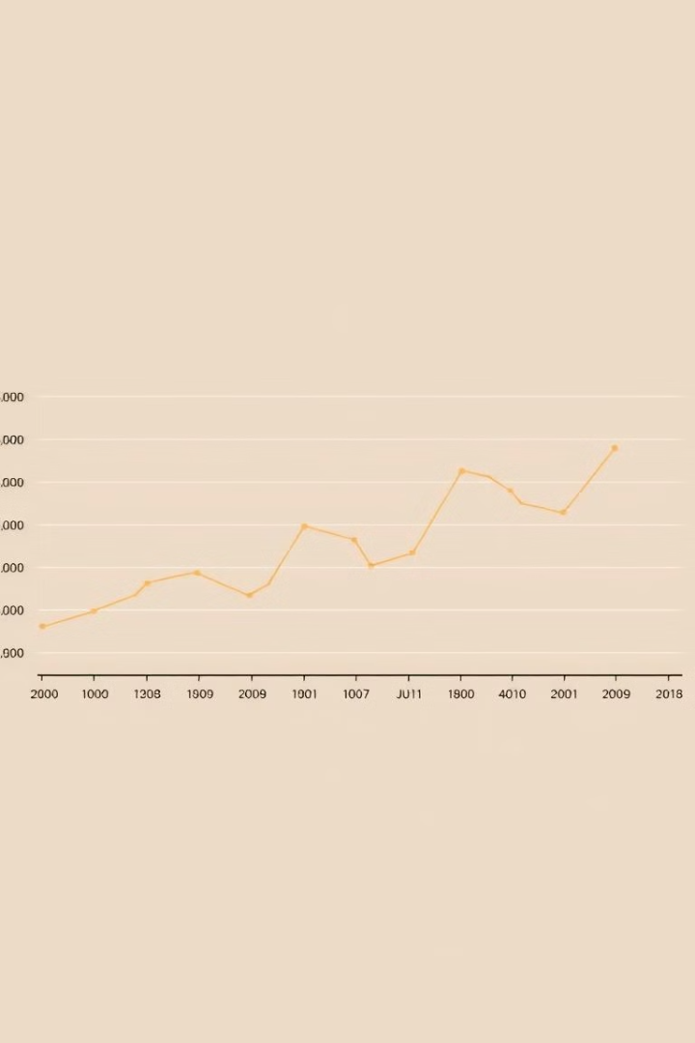
Analyzing Sales Trends and Patterns
1
Seasonal Fluctuations
Identify peaks and dips in sales throughout the year, allowing for proactive inventory management and marketing strategies.
2
Year-over-Year Growth
Analyze long-term sales trends to understand the company's overall growth trajectory and adapt accordingly.
3
Regional Variations
Examine sales data across different store locations to uncover regional preferences and optimize store-level operations.

Slide 4

Identifying High-Performing Product Categories
Apparel and Accessories
Home Goods and Decor
Clothing, shoes, and related items consistently drive strong sales, indicating customer demand in this category.
Furniture, kitchen items, and home furnishings are also among the top-performing product categories.
Electronics and Gadgets
Sports and Outdoor
Consumer electronics, smart devices, and technology-related products enjoy high sales and customer interest.
Sporting goods, fitness equipment, and outdoor gear cater to active customers and contribute significantly to overall sales.

Slide 5

Evaluating Customer Demographics and Behavior
1
Age and Lifestage
2
Income and Spending Patterns
Understand the age distribution of customers and how their shopping preferences vary across different lifestages.
Analyze customer income levels and their impact on purchasing decisions, helping to optimize pricing and promotions.
3
Channel Preferences
4
Loyalty and Retention
Identify customer preferences for in-store, online, or mobile shopping, and adapt the omnichannel experience accordingly.
Evaluate the effectiveness of the loyalty program in driving repeat business and long-term customer relationships.

Slide 6
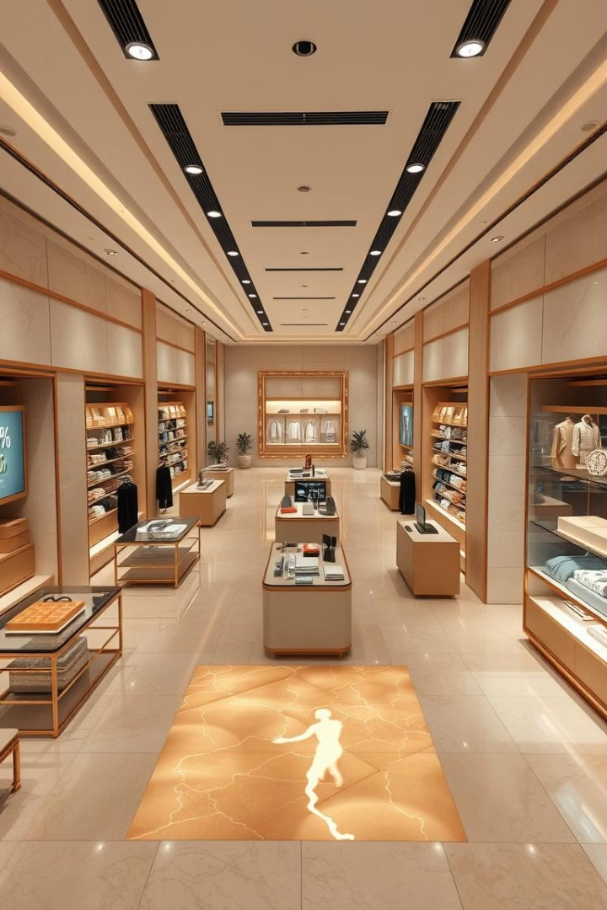
Assessing Store-Level Performance Metrics
Sales Revenue
Track monthly and annual sales figures to identify high-performing and underperforming stores.
Foot Traffic
Monitor in-store customer traffic and conversion rates to optimize staffing and layout.
Inventory Turnover
Analyze inventory levels and stock replenishment to ensure optimal product availability.
Customer Satisfaction
Gather feedback and ratings to enhance the in-store experience and address customer pain points.

Slide 7
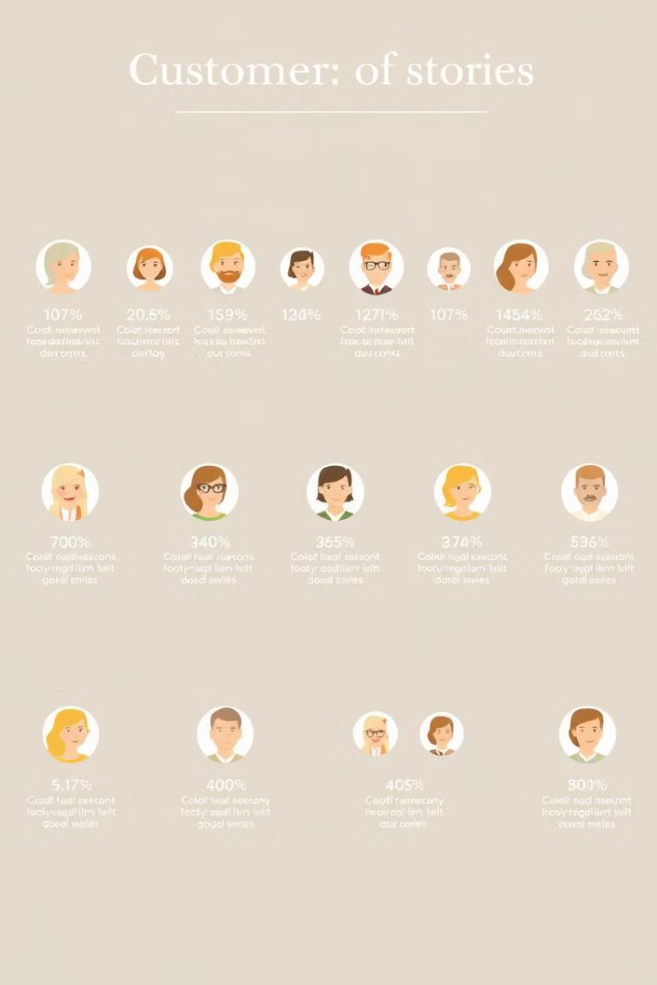




Uncovering Insights from Loyalty Program Data
Purchase Behavior
Promotional Responsiveness
Analyze customer purchase patterns, including frequency, average basket size, and preferred product categories.
Understand how customers respond to various promotional offers and discounts to optimize marketing strategies.
Loyalty Engagement
Customer Feedback
Evaluate customer engagement with the loyalty program, including enrollment, redemption, and referrals.
Leverage customer reviews, ratings, and surveys to identify areas for improvement and enhance the overall experience.

Slide 8
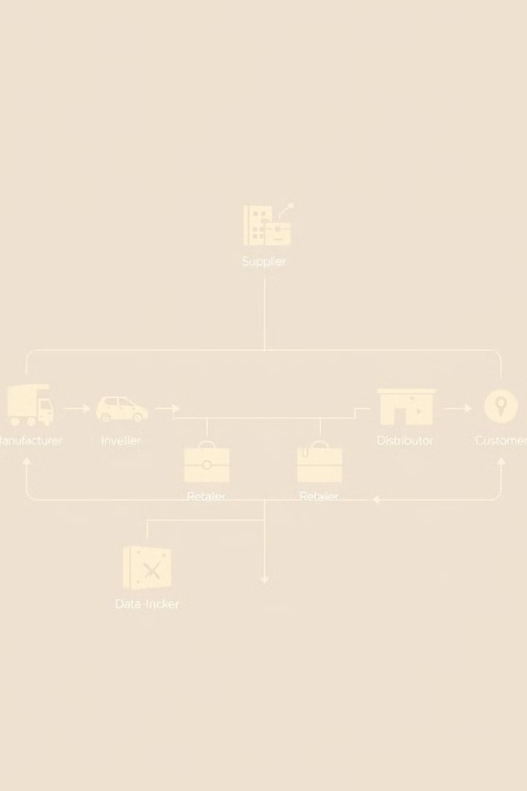



Optimizing Inventory Management and Supply Chain
Demand Forecasting
Use sales data and customer insights to accurately predict future demand and guide inventory planning.
Automated Replenishment
Implement systems to automatically reorder products based on stock levels and expected sales, reducing stockouts.
Supply Chain Optimization
Analyze logistics and distribution to identify opportunities for efficiency improvements and cost savings.

Slide 9
Leveraging Data-Driven Strategies for Growth
Targeted Marketing
Assortment Optimization
Store Network Planning
Use customer data to create personalized marketing campaigns that resonate with different customer segments.
Adjust product mix and inventory levels based on sales performance and customer preferences.
Identify optimal locations for new store openings or closures based on market analysis and customer data.

Slide 10

Conclusion and Key Recommendations
1
Continuous Data Monitoring
2
Collaborative Decision Making
Maintain a regular cadence of data analysis and reporting to stay ahead of market trends and customer preferences.
Encourage cross-functional teams to leverage data insights and work together to drive strategic initiatives.
3
Agile Adaptability
Remain flexible and responsive to rapidly changing market conditions, adjusting strategies and tactics accordingly.

